Slide 1

Electricity demand & Price forecasting
INFOSYS SPRINGBOARD
​

Slide 2

PROBLEM STATEMENT
Develop predictive models for the Spanish electricity market by integrating diverse data sources, including historical demand patterns, weather variables, economic indicators, calendar effects, and other relevant factors.
Goals:
- Predict electricity demand to ensure efficient resource allocation, grid stability, and optimal power plant operations.
- Forecast electricity prices to aid utility companies, traders, and policymakers in making informed, data-driven decision.

Slide 3

contents
Data Introduction
Exploratory Data Analysis
Feature Engineering
Data Visualization
Model implementation
Model selection
Conclusion

Slide 4

DATA INTRODUCTION
Energy Dataset:
Historical electricity demand and price data essential for analyzing past consumption patterns and pricing trends.
Shape:
Columns: 29,Rows: 35,064
Weather Features:
Historical and forecasted weather data, including temperature, humidity, wind speed, and other meteorological factors crucial for accurate demand forecasting.
Shape:
Columns: 17,Rows: 178,396
Merged Dataset:
Dataset resulting from the integration of energy and weather data to enhance analysis and prediction capabilities.
Shape:
Columns: 44,Rows: 35064

Slide 5

Exploratory Data Analysis
The EDA process involves cleaning and preprocessing the data, visualizing key relationships, engineering new features to improve model accuracy, and detecting outliers to ensure data quality.
Data Cleaning and Preprocessing
Tasks:
Clean and format data, addressing missing values and outliers.
Handle missing values (11.41%) using various techniques such as mean, mode, median, forward filling, and backward filling.
Merge and aggregate datasets after cleaning, resulting in a combined dataset of shape (35,064, 38).
Data Visualization
Goals:
Visualize relationships between electricity demand, price, and influencing factors.
Use scatter plots, line charts, and heatmaps to explore correlations and trends.

Slide 6

Feature Engineering
Feature engineering techniques, including binary encoding, one-hot encoding, and mapping, enhance the dataset by creating meaningful representations of categorical variables.
Binary Encoding
Peak Status:
Categorize high peak as 1 and off-peak as 0.
Day Type:
Categorize weekdays as 0 and weekends as 1.
One-Hot Encoding
Month Categorization:
Convert categorical variables (months) into a binary matrix representation to facilitate accurate categorization and analysis.
Mapping
Weather Description:
Transform data values using a specified function or dictionary.
Provides a clear description of weather conditions for more detailed analysis.

Slide 7
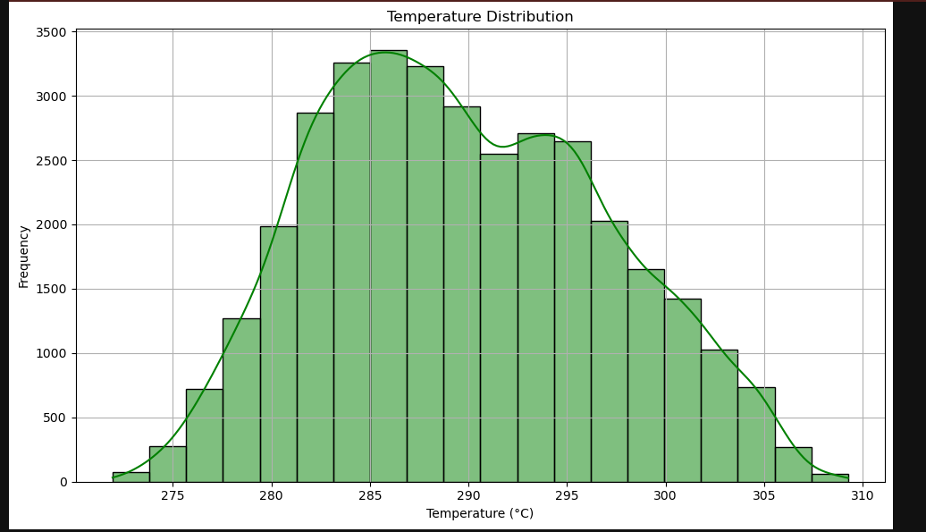
Data Visualization
The temperature ranges from 275°C to 310°C.
The most frequent temperature is around 290°C.

Slide 8
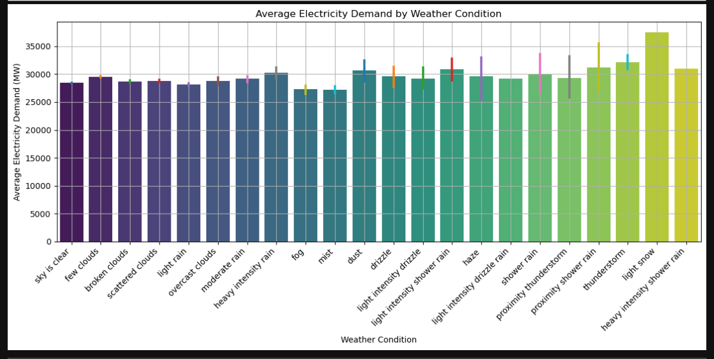
The weather condition with the highest average electricity demand is thunderstorms (around 32,000 MW).
Clear skies have the lowest average electricity demand (around 5,000 MW).

Slide 9
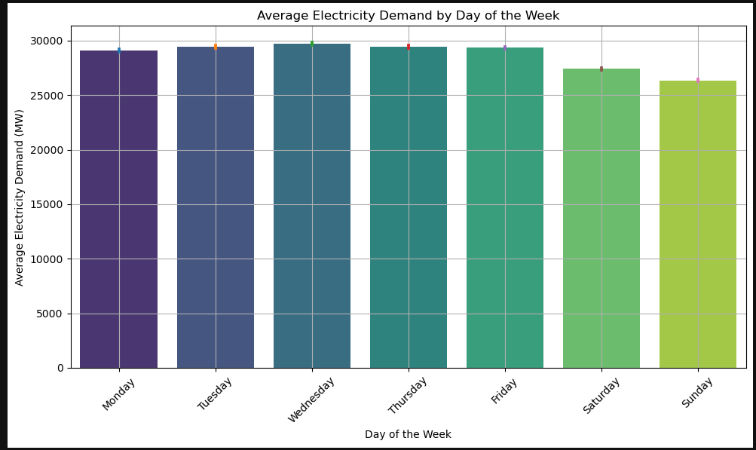
The average electricity demand is highest on weekdays, ranging from 20,000 MW to 30,000 MW.
The average electricity demand is lower on weekends, around 15,000 MW.

Slide 10

Implementation of Model Training
Data Splitting
Train Data (80%): Used to train the machine learning models.
Test and Validation Data (20%): Split into test and validation sets to fine-tune and evaluate the models.
Test Data (10%): Used to evaluate model performance after training.
Validation Data (10%): Used during training to fine-tune model parameters and avoid overfitting.
Feature Selection
Correlation Matrix (Threshold: 0.2): Features with correlation values above 0.2 are selected for model training to ensure relevance and reduce multicollinearity.
Model Evaluation
Evaluation Metrics:
Mean Absolute Percentage Error (MAPE): Measures the accuracy as a percentage of error.
Mean Absolute Error (MAE): Measures the average magnitude of errors in a set of predictions.
Root Mean Squared Error (RMSE): Measures the square root of the average squared differences between predicted and actual values.
Adjusted R²: Indicates the proportion of variance explained by the model, adjusted for the number of predictors.
R²: Represents the proportion of variance explained by the independent variables in the model.

Slide 11



Model Implementation
Linear regression
Linear regression
Random forest
Price Actual
Mean Absolute Error (MAE): 6.947934671324683
Mean Squared Error (MSE): 79.79027306735175
Root Mean Squared Error (RMSE): 8.93254012402697
R-squared (R2): 0.5916466189062363
Adjusted R-squared: 0.5908881399872166
Mean Absolute Percentage Error (MAPE): 13.728993151965781
total load actual
Mean Absolute Error (MAE): 2807.1332630292063
Mean Squared Error (MSE): 12194152.078091048
Root Mean Squared Error (RMSE): 3492.0126113877436
R-squared (R2): 0.4149327179567541
Adjusted R-squared: 0.41384600918884984
Mean Absolute Percentage Error (MAPE): 10.020559238602381
price actual
Mean Absolute Error (MAE): 9.13734937430843
Mean Squared Error (MSE): 131.60245617191865
Root Mean Squared Error (RMSE): 11.47181137274836
R-squared (R2): 0.3264804609368348
Adjusted R-squared: 0.3252294602213296
Mean Absolute Percentage Error (MAPE): 18.34696829091844

Slide 12



Model Implementation
Random forest
Gradient boosting
Gradient boosting
total load Actual
Mean Absolute Error (MAE): 1992.8404660346582
Mean Squared Error (MSE): 7193277.407561551
Root Mean Squared Error (RMSE): 2682.02859931835
R-squared (R2): 0.6548713485879407
Adjusted R-squared: 0.6542303038003486
Mean Absolute Percentage Error (MAPE): 7.112252636207889
Total Load Actual
Mean Absolute Error (MAE): 1802.5113839543753
Mean Squared Error (MSE): 6180013.805070648
Root Mean Squared Error (RMSE): 2485.9633555365713
R-squared (R2): 0.7034870602918992
Adjusted R-squared: 0.7029363147259319
Mean Absolute Percentage Error (MAPE): 6.437864167031869
Price Actual
Mean Absolute Error (MAE): 8.161350521485906
Mean Squared Error (MSE): 103.13273941464767
Root Mean Squared Error (RMSE): 10.155429061080959
R-squared (R2): 0.47218374843905975
Adjusted R-squared: 0.4712033782046988
Mean Absolute Percentage Error (MAPE): 16.276357654634683

Slide 13


Model Implementation
Lstm
lstm
Price Actual
Mean Absolute Error (MAE): 8.283076841473223
Mean Squared Error (MSE): 106.93779293230953
Root Mean Squared Error (RMSE): 10.341073103518296
R-squared (R2): 0.4527101157586908
Adjusted R-squared: 0.45169357503928276
Mean Absolute Percentage Error (MAPE): 16.603250125209133
Total Load Actual
Mean Absolute Error (MAE): 2059.219791956006
Mean Squared Error (MSE): 7691681.914721147
Root Mean Squared Error (RMSE): 2773.3881651729075
R-squared (R2): 0.6309582328178103
Adjusted R-squared: 0.6302727716128713
Mean Absolute Percentage Error (MAPE): 7.430308758500701

Slide 14
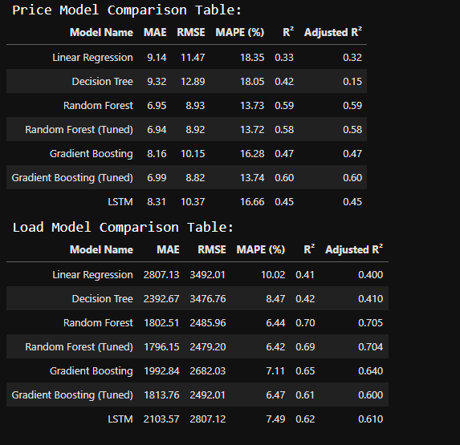
Model Comparison & Selection
Report
Model Comparison Report
Best Model for Load Prediction:
Random Forest (Tuned)
Best Model for Load Prediction:¶
Random Forest (Tuned)
These selections are based on the overall lower MAPE, MAE, and RMSE values, along with higher R² and Adjusted R² values, indicating better prediction accuracy and fit to the data.

Slide 15
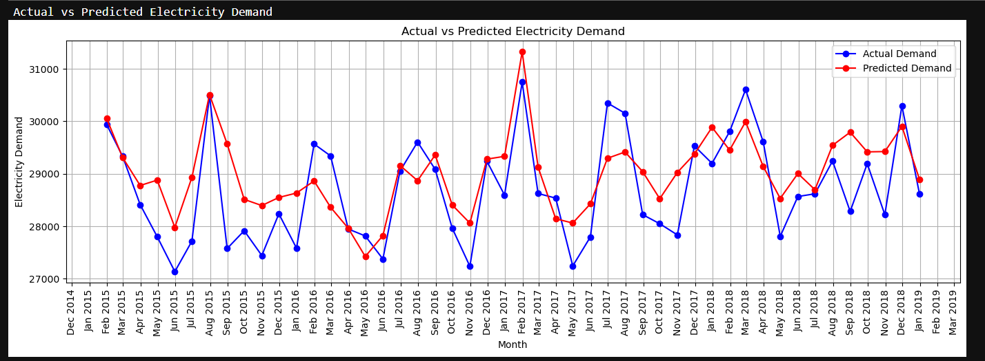
conclusion
Superior Performance: The tuned random forest model outperformed other models in forecasting electricity demand and prices.
Advanced Feature Selection: Utilizing methods such as correlation analysis and model-derived feature importance significantly improved prediction accuracy.

Slide 16

THANK YOU
Submitted by: Kumar Pushpam
email:kumarpushpam2003@gmail.com

